Slide 1

D3: Dynamic Programming
Sec 16: Fr 12:30pm-1:30pm FXB 1024
IA: Nick Frieler
Slide deck available at course drive/Discussions/Slides/Nick

Slide 2
Agenda
Dynamic programming
  Dynamic
    Dyn
    amic
  programming
    program
      pro
      gram
    ming
      m
      ing

Slide 3
When can we use DP?

Slide 4
DP problems need 2 key features
The “principle of optimality” or “optimal substructure”
  Optimal solutions to a large instance can be obtained from multiple optimal solutions to smaller instances
  There may be more than one optimal solution, but we only need at least one can be obtained like this
  This should remind you of recursion
Overlapping subproblems
  Depending on the problem, we may have to solve exponentially many subproblems
  For example, a naive recursive implementation of Fibonacci(n) requires solving ~1.618^{n} subproblems
  To make use of DP, these subproblems need to “overlap” so that we can reuse solutions we have already computed

Slide 5
The DP “cookbook”

Slide 6
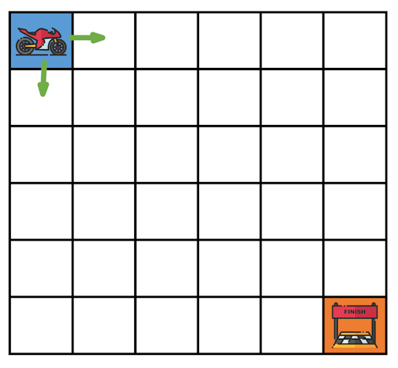
Focus on the “value” version of the problem
Instead of finding an optimal solution, focus on finding the value of an optimal solution
For example:
  Suppose you are in a motorcycle race and can only drive to the right or down
  Each square you visit adds that number of minutes to your total time
  You want to find the optimal path so you can win!
  First, figure out how long your winning (optimal) race time will be
4
7
6
6
1
2
6
6
8
6
6
6
3
4
6
2
0
6
5
2
0
5
7
4
5
6
6
9
3
6
3
9
0
6

Slide 7
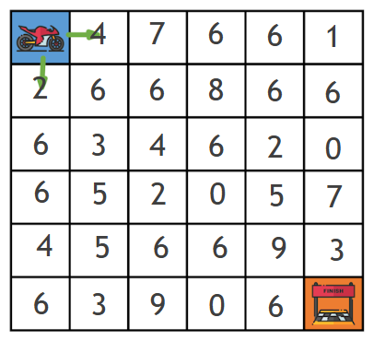
Make and use a recurrence
Now that we are focusing on the value version of the problem, come up with a recurrence for that value and use it to get the optimal value
For example:
  Figure out the minimum time it takes to get to each square in the race grid via some sort of recurrence
  The minimum total time to get to a given square should look something like:
    Total time = Square time + min(left time, up time)
0
4
11
17
23
24
2
8
14
22
28
30
8
11
15
21
23
23
14
16
17
17
22
29
18
21
23
23
32
32
24
24
32
23
29
29

Slide 8
Get the optimal solution using backtracking
Use the filled-in values to figure out the optimal solution
For example:
  Total time = Square time + min(left time, up time)
  Based on our recurrence, we can see we should pick the previous square that has the smaller value
0
4
11
17
23
24
2
8
14
22
28
30
8
11
15
21
23
23
Note that there’s more than 1 optimal path
  In the 3rd row, 2nd column, we could have backtracked either left or up from the 11 to one of the two 8s
14
16
17
17
22
29
18
21
23
23
32
32
24
24
32
23
29
29

Slide 9
Runtime analysis, YAY
Analyze your algorithm to determine runtime
Likely used a DP table
  Bound the number of table entries filled
  Bound the time to fill each entry
For example:
  Total time = Square time + min(left time, up time)
  Based on our recurrence, we can see each table entry takes Θ(1) time to fill
  If our grid is n x m, there are Θ(n * m) entries
  Therefore, runtime is Θ(n * m)
0
4
11
17
23
24
2
8
14
22
28
30
8
11
15
21
23
23
14
16
17
17
22
29
18
21
23
23
32
32
24
24
32
23
29
29

Slide 10
Any questions before discussion problems?

Slide 11
Discussion Problems

Slide 12
Q1: Who climbs 3 steps at once??
We define the function CS(n) as follows:
There are n steps to climb. Return the number of ways there are for a person standing at the bottom of the stairs to reach the top if they can climb either 1, 2, or 3 steps at a time.
Devise a recurrence for computing CS(n).

Slide 13
Q1: Who climbs 3 steps at once??
SOLUTION
We define the function CS(n) as follows:
There are n steps to climb. Return the number of ways there are for a person standing at the bottom of the stairs to reach the top if they can climb either 1, 2, or 3 steps at a time.
Devise a recurrence for computing CS(n).
Recurrence:
For n ≥ 3,
CS(n) = CS(n-1) + CS(n-2) + CS(n-3)
Base Cases:
CS(0) = CS(1) = 1
CS(2) = 2

Slide 14
Q2: McNuggets
You and some friends are really hungry after your Thirsty Thursday Theatrics, so you decide to online order some chicken McNuggets. There are several order sizes you can get, so you put each of the sizes into an array M[1, …, n]. Being the brains of this operation, your friends task you with figuring out if there’s some combination of meals you can order so that your total is exactly t nuggets.
Devise an algorithm to solve this problem.

Slide 15
Q2: McNuggets
SOLUTION
Setup:
  Define S(i) as true or false depending on if you can purchase i nuggets
Base Cases:
  S(0) = true
  S(i) = false for all i < 0
Recurrence:
  If S(i - M[1]) is true, then S(i) is true
  If S(i - M[2]) is true, then S(i) is true
  …
  S(i) = OR(S(i - M[j])) for j = 1, …, n
Answer:
  S(t) is the truth value of whether or not we can buy exactly t nuggets

Slide 16
Q2: McNuggets
Now that you have successfully developed an algorithm to determine whether or not you can buy the nuggets, you thought you were in the clear. BUT, your friends are really hungry and keep asking you how long until the nuggets arrive.
Do a runtime analysis on an implementation of the recurrence that uses DP.

Slide 17
Q2: McNuggets
SOLUTION
Now that you have successfully developed an algorithm to determine whether or not you can buy the nuggets, you thought you were in the clear. BUT, your friends are really hungry and keep asking you how long until the nuggets arrive.
Do a runtime analysis on an implementation of the recurrence that uses DP.
Making a table for the values S(0), S(1), …, S(t), we have t + 1 = Θ(t) entries to fill out
For each entry, we do an OR of n values (the number of meal sizes), so each entry takes O(n) time to compute
In total, the time to compute S(t) is O(t * n)

Slide 18
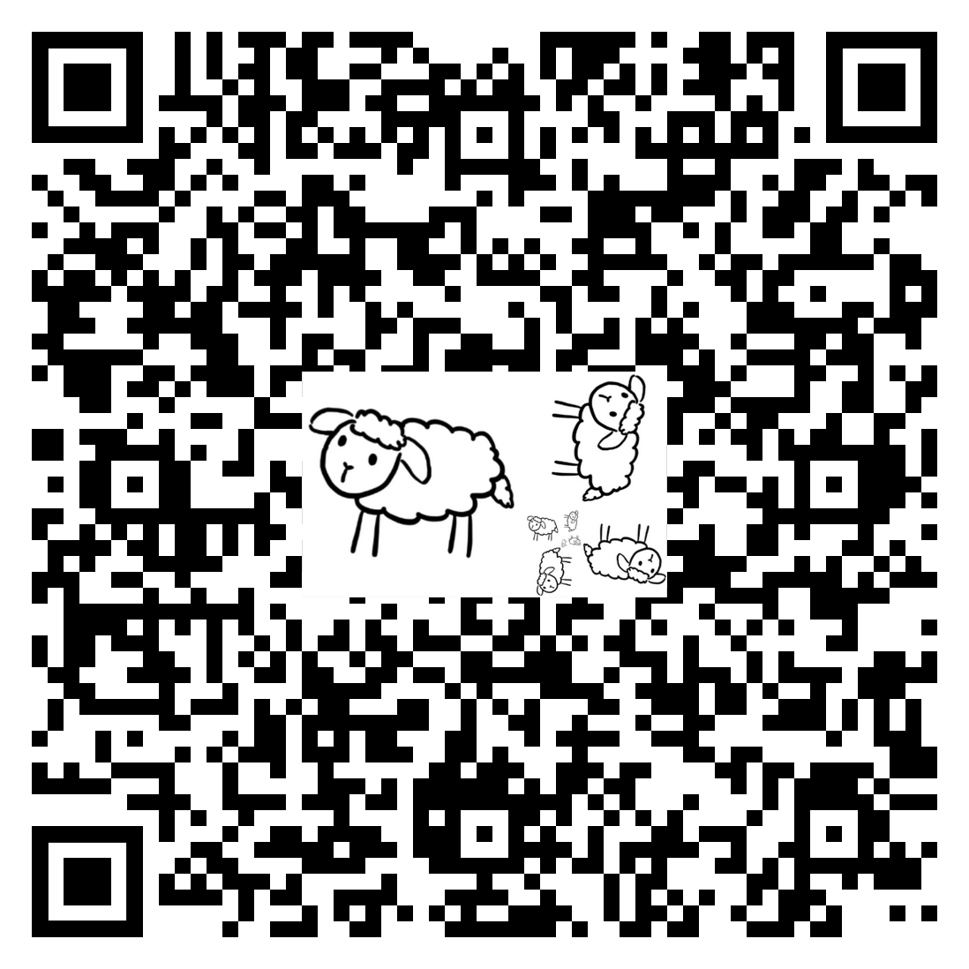
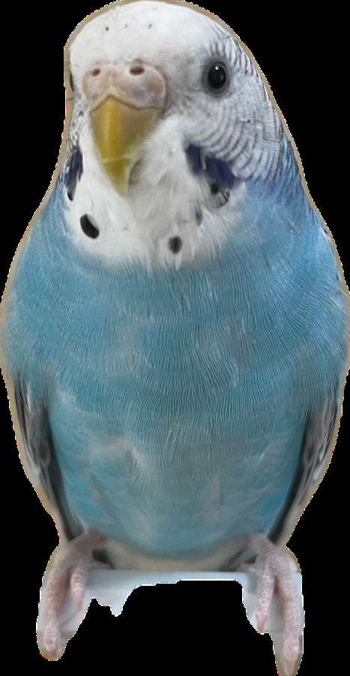
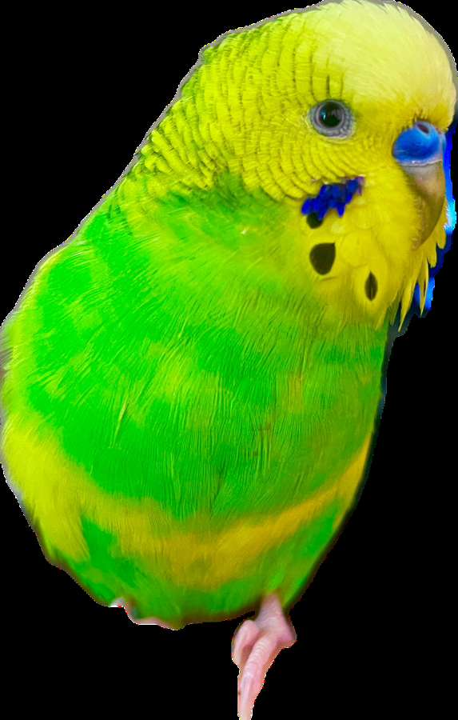
Attendance

Slide 19
Q3: Longest Arithmetic Subsequence
LAS(A, d): Given an array of integers A and a difference d, return the length of any longest arithmetic subsequence in A with difference d. That is, return the length of a longest (not necessarily contiguous) subsequence S of A such that S[i+1] − S[i] = d for each i.
Give a recurrence relation for LAS suitable for DP.

Slide 20
Q3: Longest Arithmetic Subsequence
SOLUTION
LAS(A, d): Given an array of integers A and a difference d, return the length of any longest arithmetic subsequence in A with difference d. That is, return the length of a longest (not necessarily contiguous) subsequence S of A such that S[i+1] − S[i] = d for each i.
Give a recurrence relation for LAS suitable for DP.
Let L[i] for i = 1, …, n be the longest arithmetic subsequence of A[1, …, n] with difference d ending at index i
Look at all of the values L[j] where j < i AND A[i] - A[j] = d
  Add +1 to the biggest value
  If there are no such j, then set L[i] = 1
Take the max of the L[i]

